Slide 1

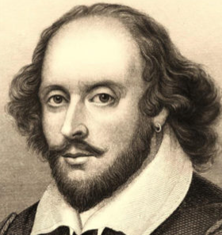
The Sentimental of Shakespeare BERT-Based Analysis Using Transfer Learning
Capstone Project Part B
23-2-R9
Students: Dorin Bachar & Moshe Moalem
Supervisors: Dr. Renata Avros Prof. Zeev Volkovich

Slide 2
Table of contents
The Project's Objective
BERT vs ALBERT
Mathematical tools
Research Process
Shakespeare-BERT Pipeline
Impostors Models Training Process
7. Results
8. App Video
9. GUI
10. Diagrams
11. Testing Plan
12. Conclusions

Slide 3
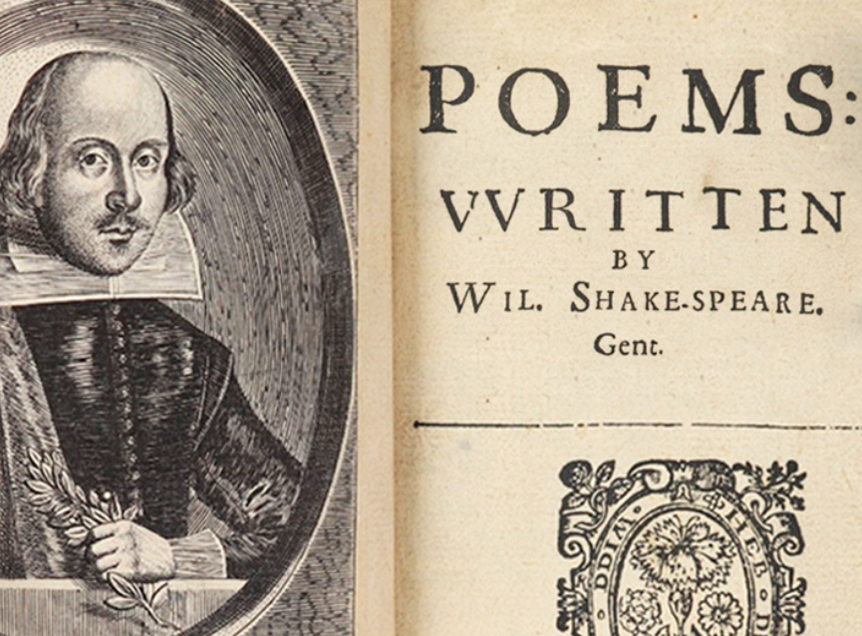
The Project's Objective
Our primary objective is to employ advanced machine learning techniques to distinguish authentic Shakespearean texts from those written by other known authors, referred to in our project as "impersonators"
Using the Shakespeare-BERT model, we fine-tune on distinct pairs of imposter writers, applying the model to predict and analyze texts attributed to Shakespeare. This approach allows us to evaluate the stylistic fingerprints specific to Shakespeare and to identify texts whose authorship might be misattributed.
By accurately predicting Shakespearean data using models trained on diverse pairs of authors, we demonstrate the robustness and consistency of our methodology, confirming the reliability of the outcomes across different author combinations.
This project highlights the potential of BERT combined with Dynamic Time Warping (DTW) and Isolation Forest algorithms for sentiment analysis and anomaly detection, with a primary focus on Shakespearean text.

Slide 4
BERT Model
BERT, standing for Bidirectional Encoder Representations from Transformers, utilizes the Transformer's architecture in a novel way.
It reads text in both directions, understanding the context from both sides of a word.
This bidirectional approach enhances the model's understanding of language semantics.
After pre-training, BERT proceeds to fine-tuning for specific tasks such as text classification or sentiment analysis.
This fine-tuning process enables BERT to specialize in a particular task.
BERT leverages the comprehensive linguistic knowledge acquired during pre-training to enhance its performance in the chosen task.

Slide 5
ALBERT Model
ALBERT, a Lite version of BERT, provides improved efficiency without compromising performance.
It achieves this through techniques such as parameter sharing, factorized embedding parameterization, and the addition of Sentence Order Prediction (SOP) in the pre-training process.
ALBERT is adept at various NLP tasks, including sentiment analysis, similarly to BERT.

Slide 6
BERT vs ALBERT
Feature / Model | BERT | ALBERT
Efficiency | Large number of parameters | Parameter sharing and factorization
Pre-training Objectives | Masked Language Modeling (MLM) and Next Sentence Prediction (NSP) | MLM,NSP, SOP(Sentence Order Prediction)
Training Time | Longer due to extensive pre-training | Shorter due to parameter reduction
After experimenting with models, we selected for a large BERT model for our project due to its superior performance compared to the tested ALBERT model.

Slide 7
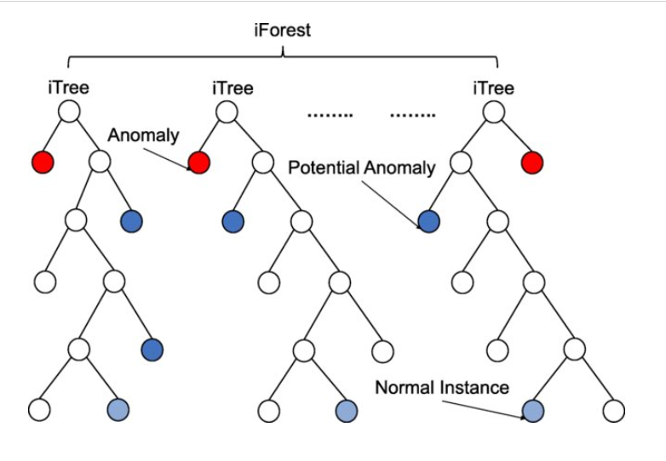
Isolation Forest
Isolation Forest: An anomaly detection algorithm developed by Fei Tony Lin in 2008.
Focuses on isolating anomalies instead of modeling normal instances within a dataset.
Divides the data into n trees to efficiently isolate anomalies, leveraging each tree's contribution in the process.
Utilizes random decision trees to segment data by randomly selecting features and split values.
Recursively splits the data until anomalies are isolated into their own leaf nodes.
Figure 1,isolation forest example [source]

Slide 8
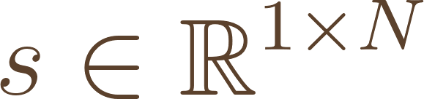

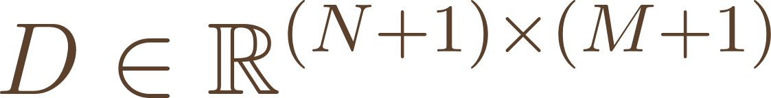
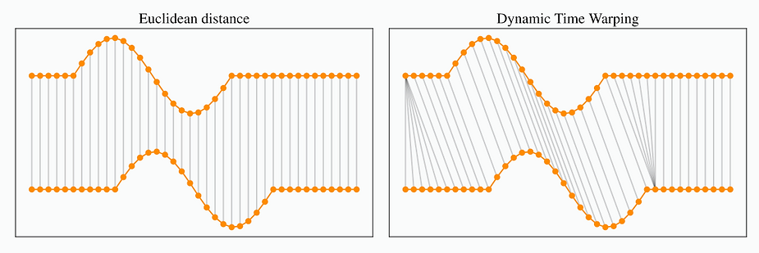
Dynamic Time Warping (DTW)
Algorithm that calculates similarity between two data sequences that may be in different lengths by stretching or compressing the time intervals of the sequences to minimize their overall distance.
Cost Matrix: Computes a matrix of costs that represents the distance between elements of two sequences.
Optimal Path: Finds the path through the cost matrix that minimizes the total distance, indicating the best alignment.
for sequences, and , cost matrix
For i 1-> n
For j 1->m
Figure 2, Euclidean distance VS DTW [source]

Slide 9
Research Process
Refinement project goals
BERT Training Challenges
Long training time
Transition to Efficient Methods
Fine-tuning instead of complete training
BERT Model
Shifted training model to BERT-L12 which achieved the best results
Models Choice
Switched different models for better results
Parameter Set-up
Adjusted chunk sizes, batch sizes, and tested additional layers like Dropout and Batch Normalization
Advanced Distance Computing
Employed Dynamic Time Warping instead of Euclidean distance
Anomaly Detection
Implemented the isolation forest algorithm
Results Analyzing

Slide 10
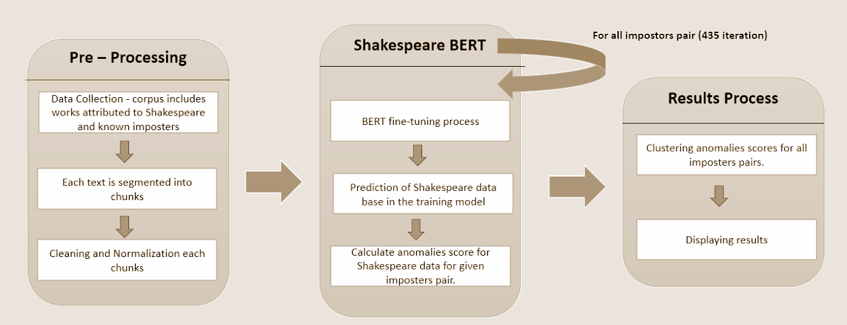
Shakespeare-BERT Pipeline
Figure 3, Model Flow-Chart.

Slide 11
Imposters Models Training Process
Framework and Tools:
Utilized TensorFlow architecture and pipeline functions for robust model training.
Employed Google Colab Pro with GPU acceleration to enhance training efficiency.
Training Dynamics:
435 Different Models: Corresponding to the number of imposters pairs.
Training Parameters: Each imposters pair model trained over 5 epochs average training of two hours.
Monitoring and Outputs:
Model Logs: Include iteration number (imposters pair model), imposters' names, loss, and accuracy to monitor learning performance.
Anomaly Detection: Identification of Shakespeare texts that deviate from norms, using anomaly scores and summed distances.
Data Storage: Anomaly and distances scores along with model predictions and distance scores saved in files for analysis purposes.
Efficiency Enhancements:
Checkpoint Resumption: Script modifications allow training to resume from the last saved state, significantly reducing redundant training time.

Slide 12
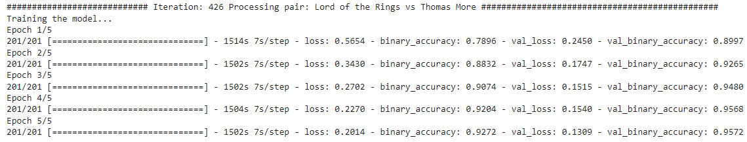
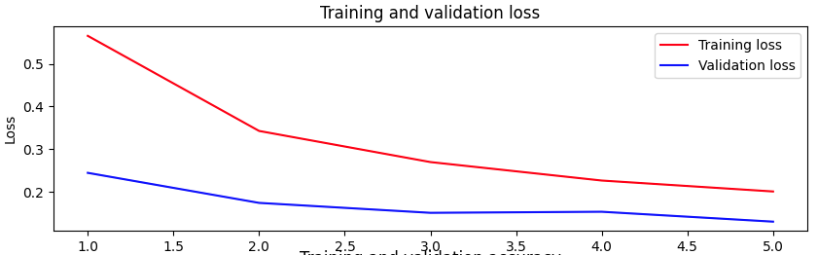
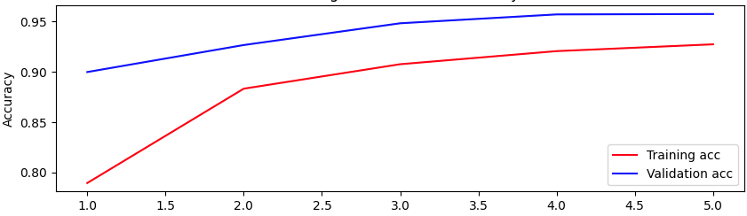

Single Model Training Results (Example)
Figure 3, training results for each epoch
Figure 4, loss function
Figure 5, accuracy function
Figure 6, results of final epoch

Slide 13
Single Model Outliers Log (Example)
Outlier Detection Results:
text to classify.txt 0
Arden of Feversham.txt 1
King Henry IV, Part 1.txt 2
KING EDWARD III by Shakespeare.txt 3
A LOVERS COMPLAINT.txt 4
A Yorkshire Tragedy by Shakespeare.txt 5
AS YOU LIKE IT.txt 6
A MIDSUMMER NIGHT_S DREAM.txt 7
CYMBELINE.txt 8
KING HENRY V.txt 9
KING HENRY VI Part II.txt 10
Fair Em by Shakespeare.txt 11
KING HENRY VI part I.txt 12
KING RICHARD II.txt 13
KING HENRY VIII.txt 14
KING HENRY VI Part III.txt 15
KING JOHN.txt 16
KING RICHARD III.txt 17
Love_s Labour_s Lost.txt 18
Merchant of Venice.txt 19
MEASURE FOR MEASURE.txt 20
MUCH ADO ABOUT NOTHING.txt 21
Locrine Mucedorus by Shakespeare.txt 22
…
Potential outliers based on distance sum:
text to classify.txt 0
Fair Em by Shakespeare.txt 10
The Life and Death of the Lord Cromwell by Shakespeare.txt 31
The Merry Devill of Edmonton by Shakespeare.txt 33
THE TRAGEDY OF KING LEAR.txt 42

Slide 14
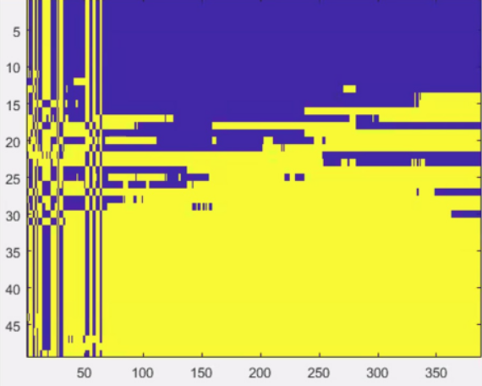
Clustered Data Results
Shakespeare's texts
Iterations
Figure 7,Shakespeare's texts clustering along different models.

Slide 15
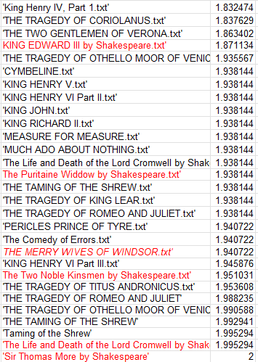
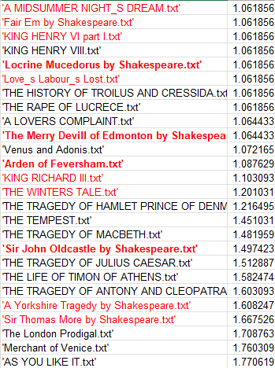
Over all models Results
Figure 8, Over all models Results.

Slide 16
Results (Examples)
Clear Identification of Shakespearean Texts: "The Tragedy Romeo and Juliet" (Score: 1.9882)
One of Shakespeare's famous plays that indeed received a high score.
Misclassification Issues: “A Midsummer Night's Dream” (score 1.06)
May reflect the model's difficulty in capturing the unique comedic style and linguistic subtleties of Shakespearean comedies.
Correct Identification of Non-Shakespearean Texts: “Fair Em by Shakespeare” (Score: 1.06)
Historically, this play has uncertain authorship and is often not included in the Shakespearean canon. The model’s low score supports the argument that it may not have been written by Shakespeare.

Slide 17

App Video

Slide 18
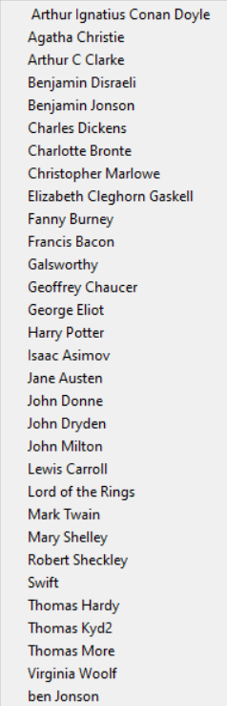
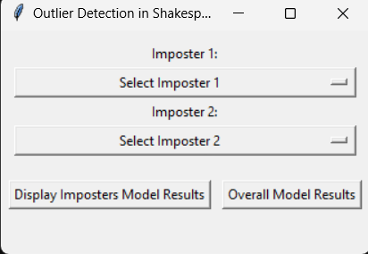
GUI
Figure 9,system's main page.
Figure 10,imposters list.

Slide 19
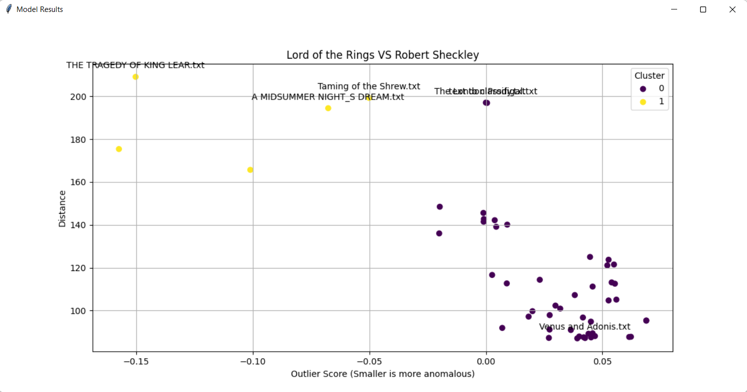
Displaying Imposters Pair Model Result(Example)
Figure 11,example, results for imposters model

Slide 20
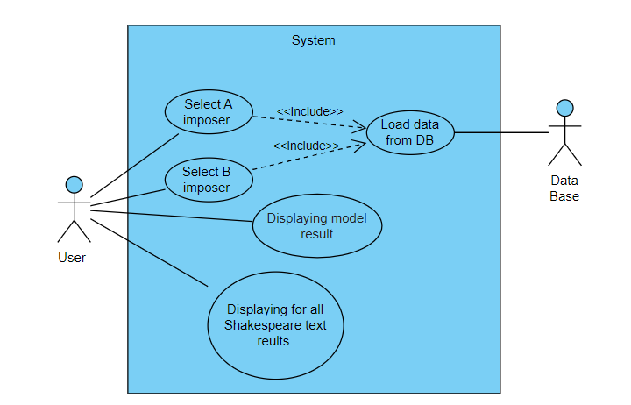
Diagrams
Use Case
Figure 12, use case diagram

Slide 21
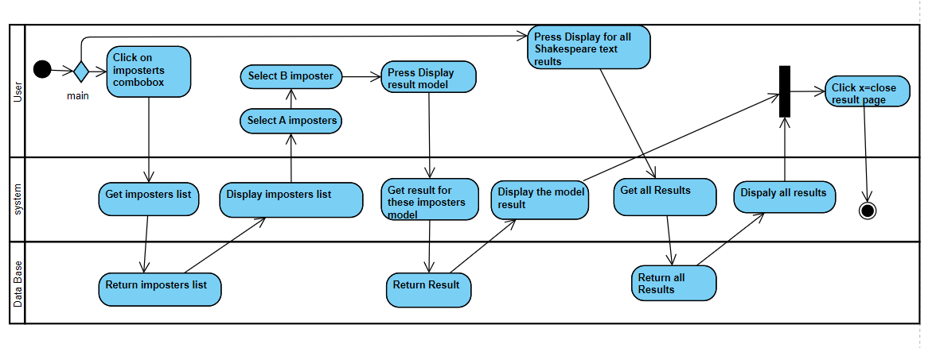
Diagrams
Activity Diagram
Figure 13, Activity Diagram

Slide 22
Testing Plan
Test Number | Test Subject | Expected Result | Pass/Fail
1 | Open the GUI. | The GUI loads successfully. | Pass
2 | Select the first imposter name from the combo box. | The name of the first imposter appears in the first combobox. | Pass
3 | Select the second imposter name from the combo box. | The name of the second imposter appears in the first combobox. | Pass
4 | Select two imposters and click the Display model result button. | Open the modal result window. | Pass

Slide 23
Testing Plan
5 | Click the display model result button without filling in all the fields. | Error message – Pair not found within the valid range. | Pass
6 | Select imposter A and not imposer B and click the Display model result button. | Error message – Pair not found within the valid range. | Pass
7 | Select imposter B and not imposer A | It is not possible to select impersonator B before impersonator A | Pass
8 | Click the all for the Shakespeare texts results. | open the graph results window. | Pass

Slide 24
Conclusions
Employed the Shakespeare-BERT model to effectively distinguish between authentic Shakespearean texts and imposters
Historical Language Variation: Recognize that some inaccuracies in model performance may stem from the substantial linguistic changes over the 400 years since Shakespeare's texts were written.
Continuous Calibration: Highlight the necessity for ongoing calibration of the model to refine its accuracy and adapt to the nuances of Early Modern English.
Emphasizes the importance of ongoing advancements in AI for expanding the horizons of literary studies.

Slide 25
Thanks
Dorin and Moshe

Slide 26
References
[1] https://www.researchgate.net/publication/352017898_Point-Denoise_Unsupervised_outlier_detection_for_3D_point_clouds_enhancement/figures?lo=1&utm_source=google&utm_medium=organic
[2 ]https://rtavenar.github.io/blog/dtw.html
https://www.youtube.com/watch?app=desktop&v=vsGN8WqwvKg
https://cherkov.com/art-and-not-only/william-shakespeare/

Slide 27
Back-up

Slide 28
BERT Training Process
Two-Stage Training Approach:
Pre-training Tasks:
Trained on unlabeled data for learning language representation while using 2 methods:
Masked Language Modeling (MLM) to understand correlation between words in the same sentence.
Next Sentence Prediction (NSP) to understand correlation between different sentences.
Fine-tuning Process:
After pre-training, BERT is fine-tuned for specific downstream tasks, such as text classification or sentiment analysis.
Fine-tuning allows BERT to specialize in a particular task while still leveraging the rich linguistic knowledge acquired during pre-training.

